Slide 1
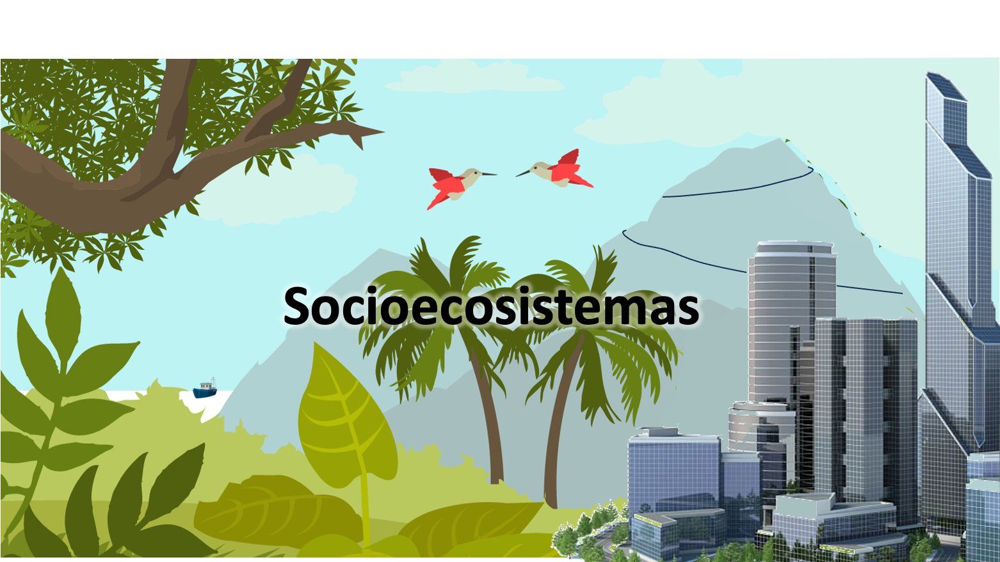
Socioecosystems

Slide 2
¿What is a socioecosystem?
A set (system) of biophysical and social factors interacting in a resilient and sustainable manner.
Complex adaptive system in which there are hierarchies of scale at different levels:
Spatial.
Temporal.
Organisational.
Notes:
The fact that it is sustainable makes us think that what we have at present is not a socio-ecosystem. The concept is theoretical. Just like the concept of ecosystem. The difference is that, for us, this socio-ecosystem is a goal to reach.
The fact that we can't see socio-ecosystems now doesn't mean that there weren't any in the past?

Slide 3
Implications of the concept
We transcend the idea of Nature without humans.
The idea of a society independent of Nature also ceases to make sense.
Biophysical limits to the growth of human societies.
Their analysis requires interdisciplinary visions and a multitude of methods.
There is no room for a reductionist and mechanistic analysis.
Theoretical conceptual framework that brings us closer to sustainability (and, in our case, to ecosystem management).

Slide 4
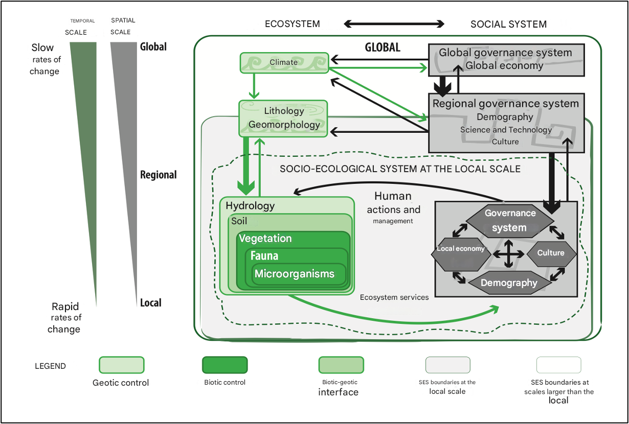
Hierarchies of scale in socio-ecosystems

Slide 5
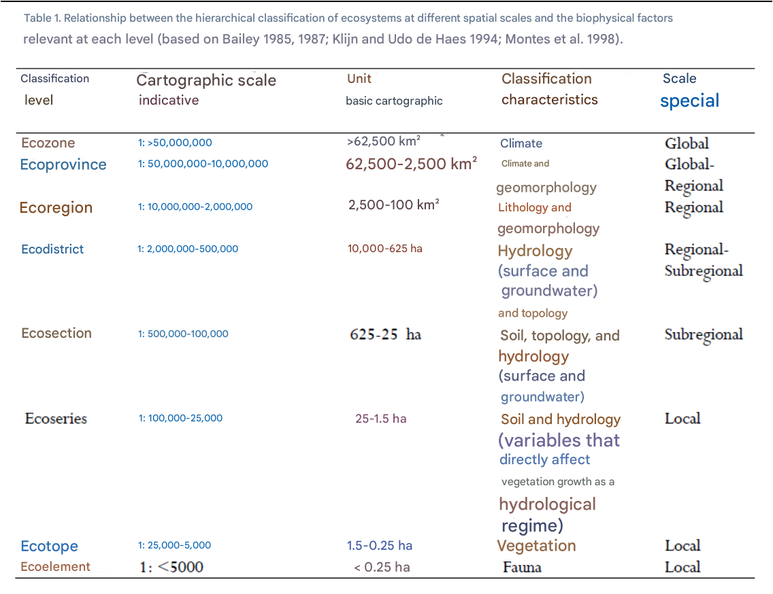
Hierarchies of scale in socio-ecosystems

Slide 6
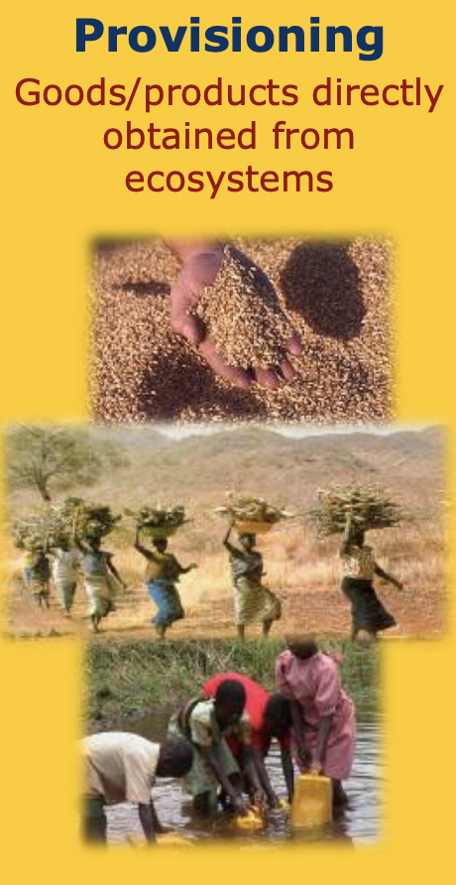
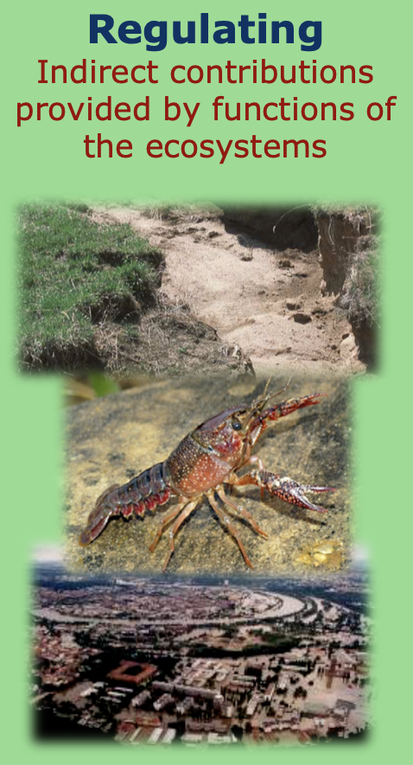
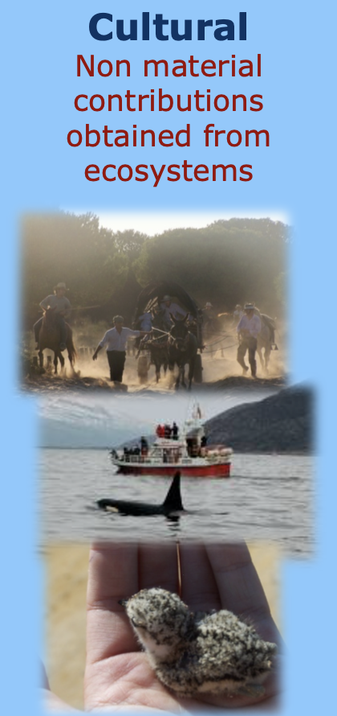
Ecosystem services
Goods and services provided by ecosystems to humans

Slide 7
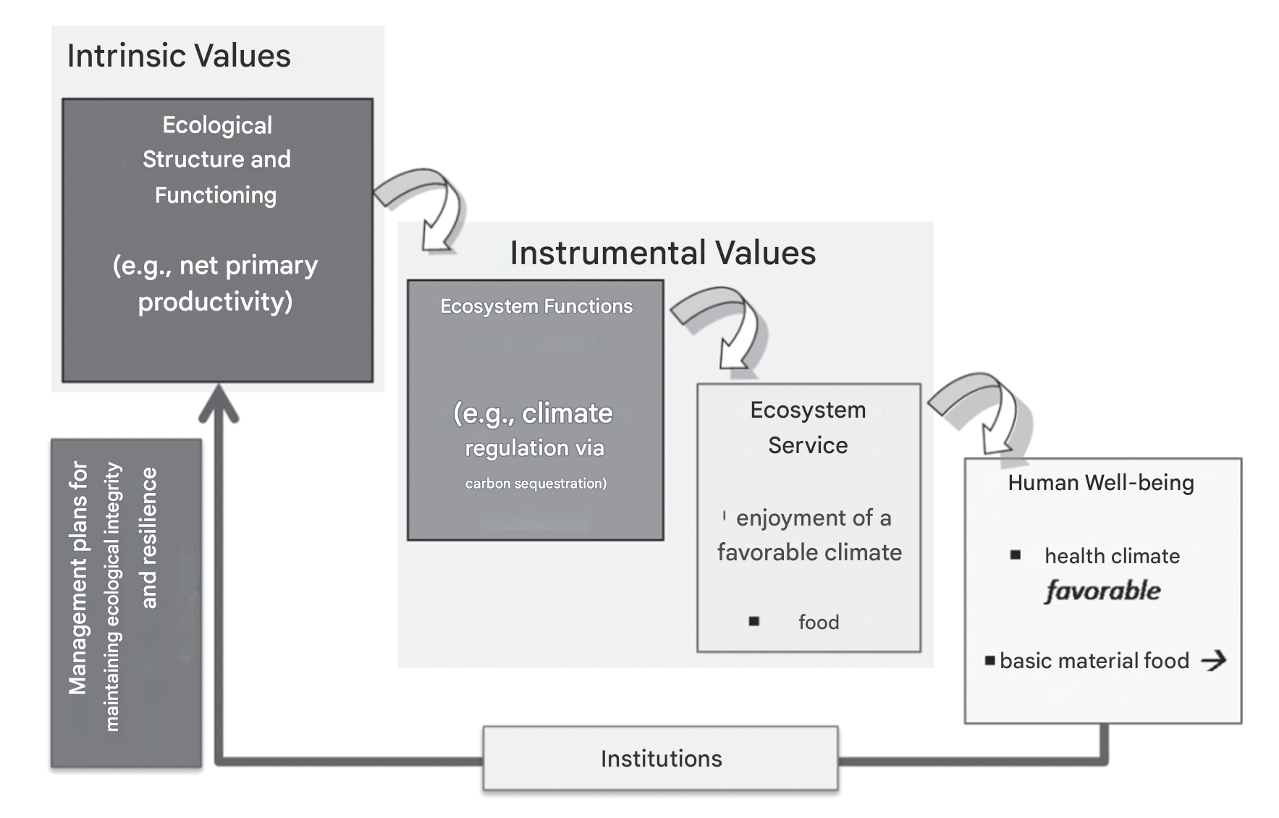
Ecosystem services
Goods and services provided by ecosystems to humans

Slide 8
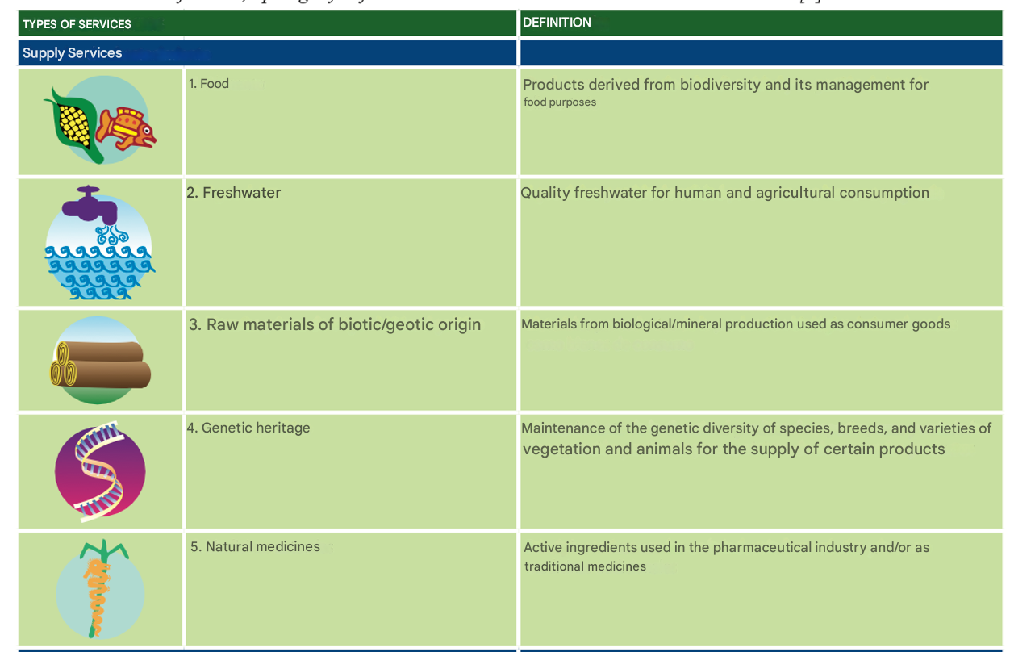
Ecosystem services
Goods and services provided by ecosystems to humans

Slide 9
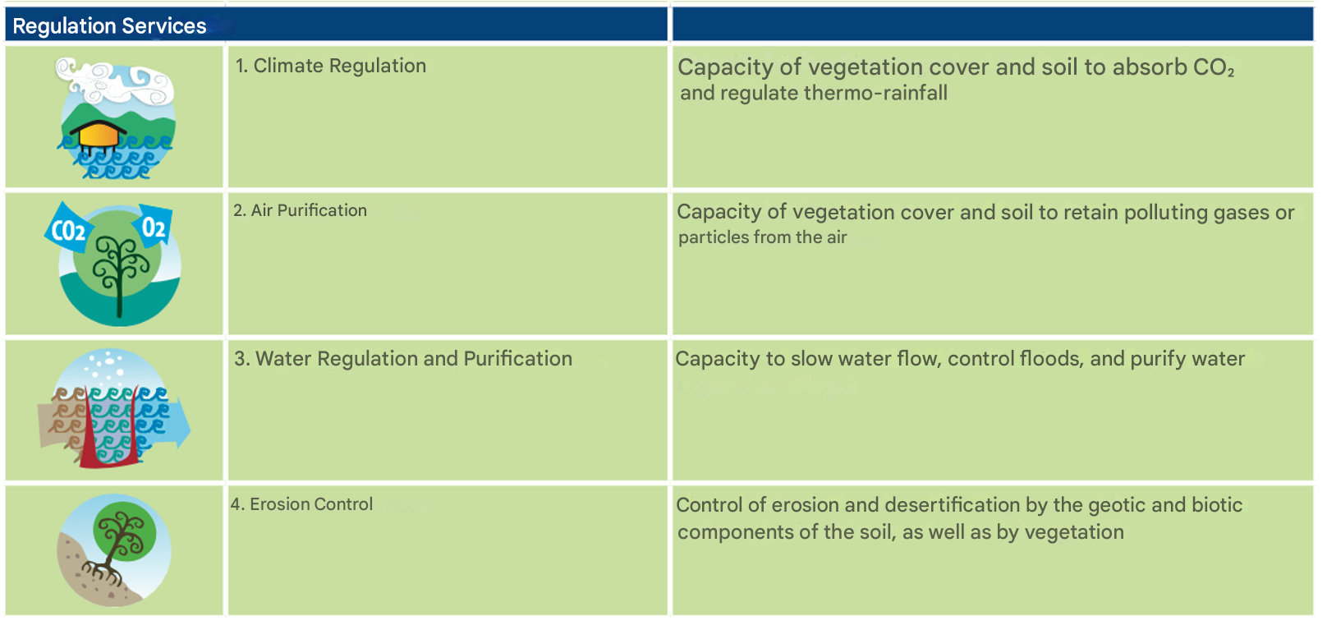
Ecosystem services
Goods and services provided by ecosystems to humans

Slide 10
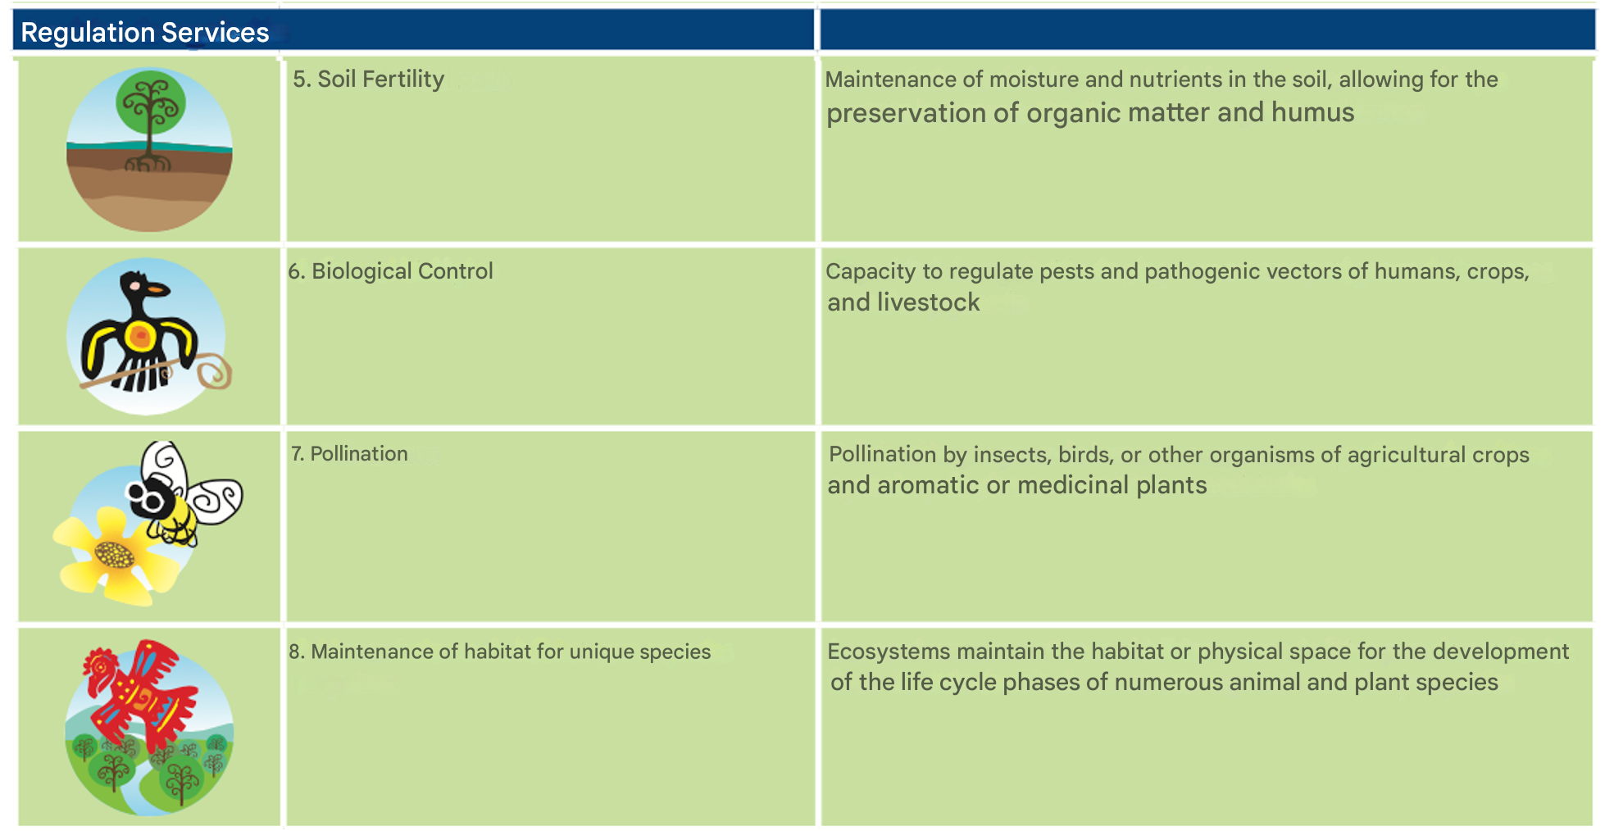
Ecosystem services
Goods and services provided by ecosystems to humans

Slide 11
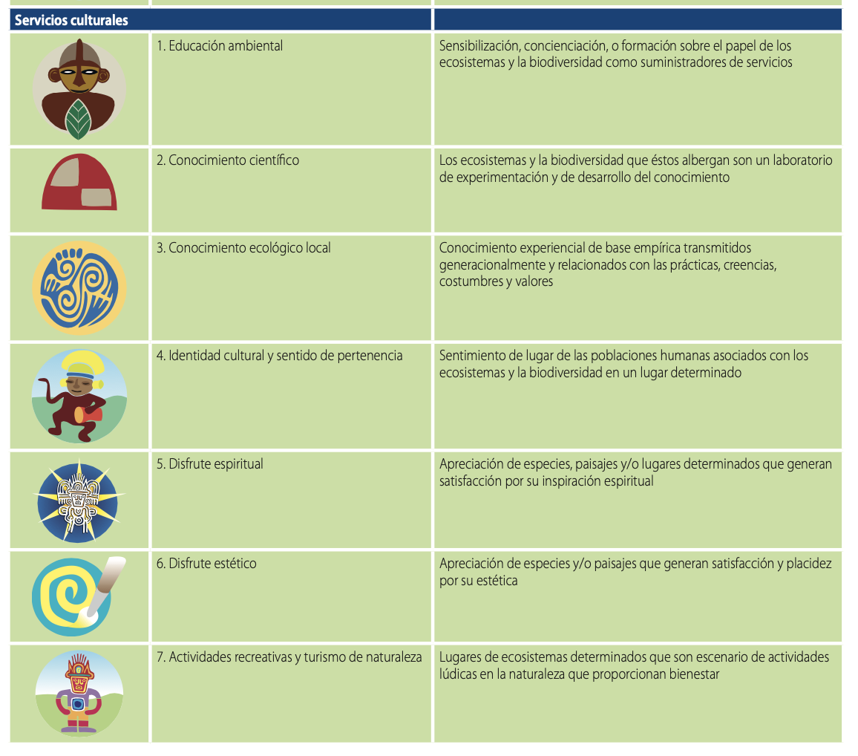
Servicios de los ecosistemas
Bienes y servicios suministrados por los ecosistemas a los humanos.

Slide 12
Ecosystem services
Goods and services provided by ecosystems to humans
They can be considered as an emergent property of socio-ecosystems.
Also as a common framework for comparing ecosystems.
Allows incorporation of the economic component: economic ecology.
Their quantification and mapping are key to advancing sustainability.

Slide 13
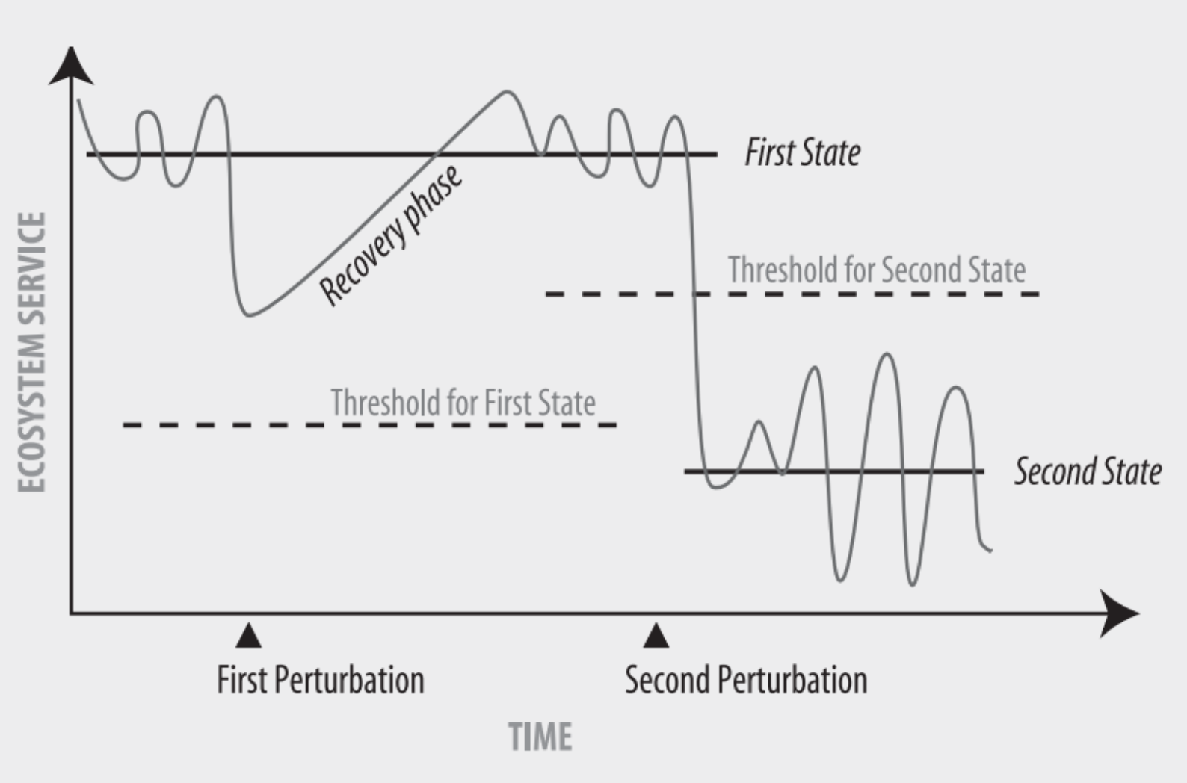
Dynamics within socioecosystems

Slide 14
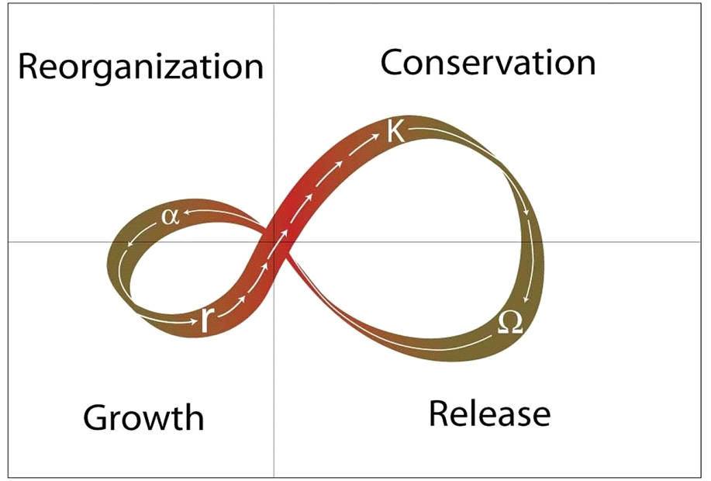
Dynamics within socioecosystems
Panarchy
Opportunity
Potential for change or available resources
Exploitation
Connectivity or integration
Disconnected
Connected

